Slide 1
Round table
Creative coding – Katherine Bennet
By: Tyler Mechura

Slide 2
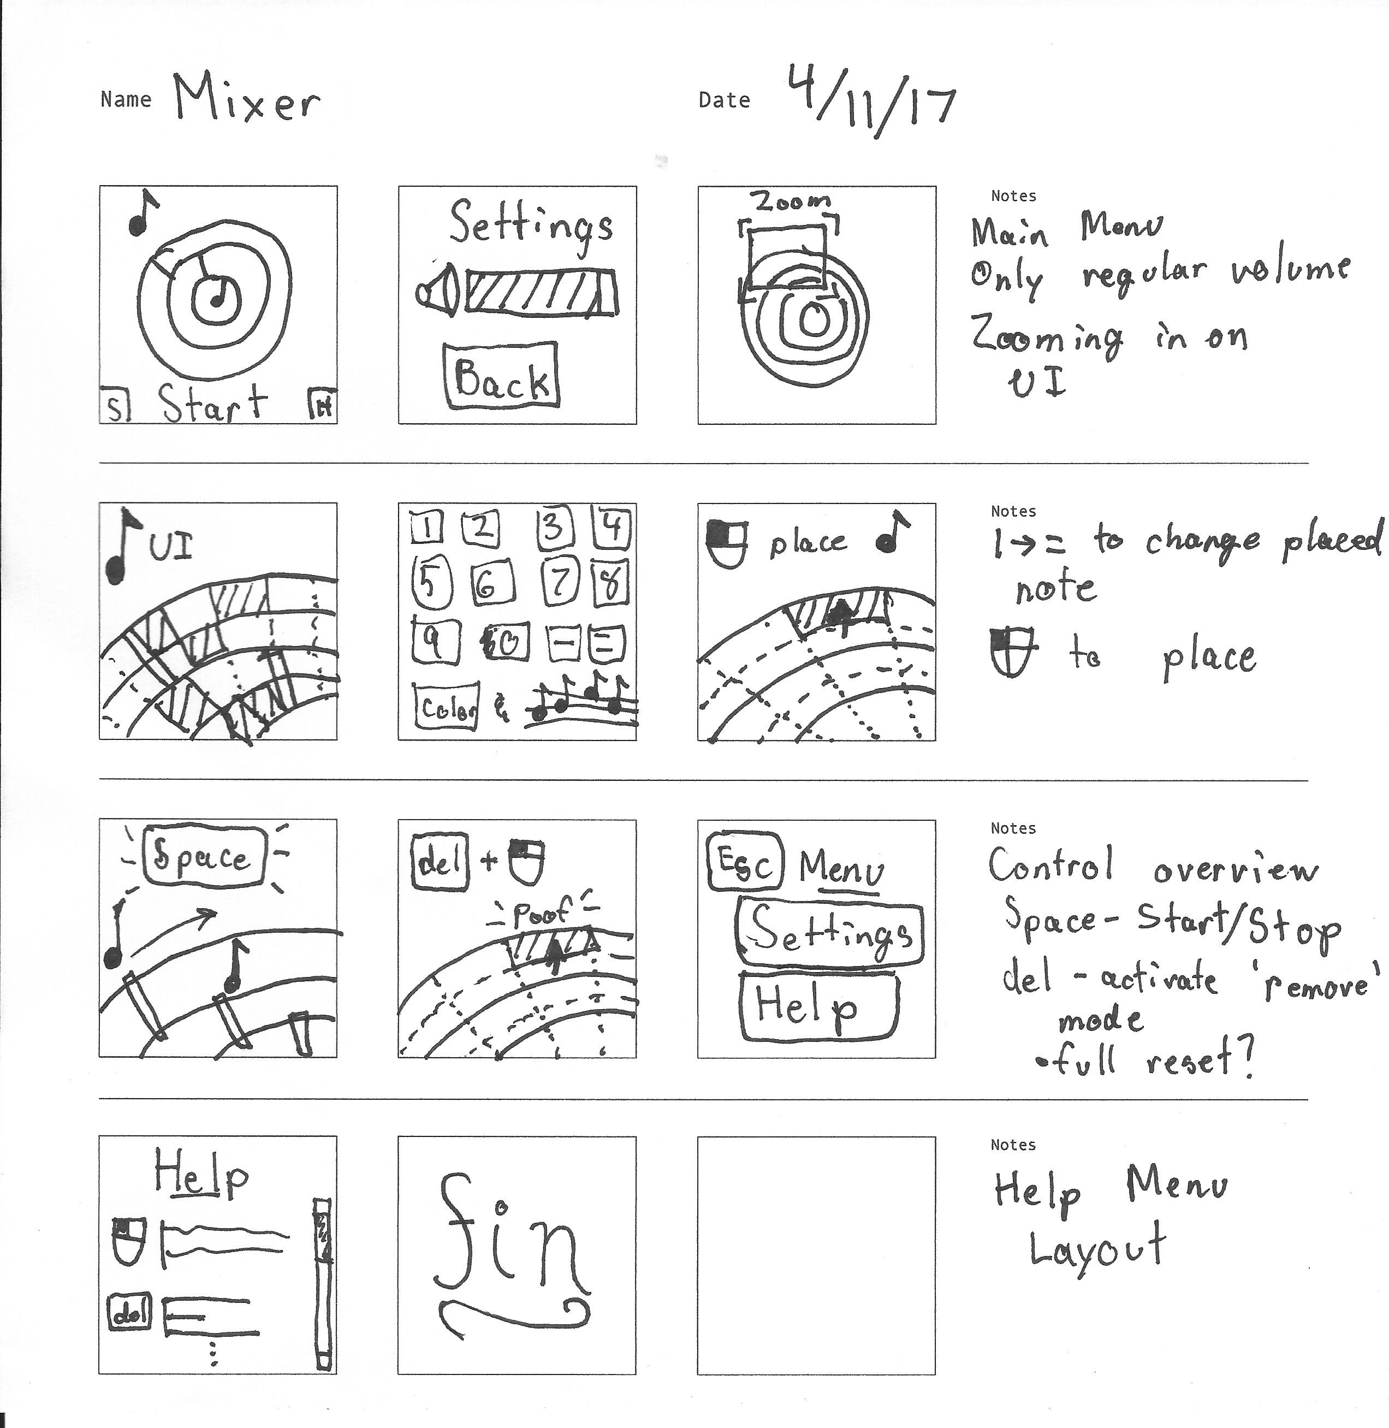
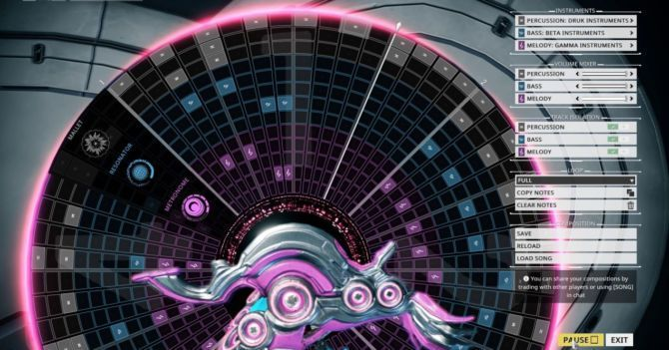
Mixer
Warframe – Octavia Frame

Slide 3
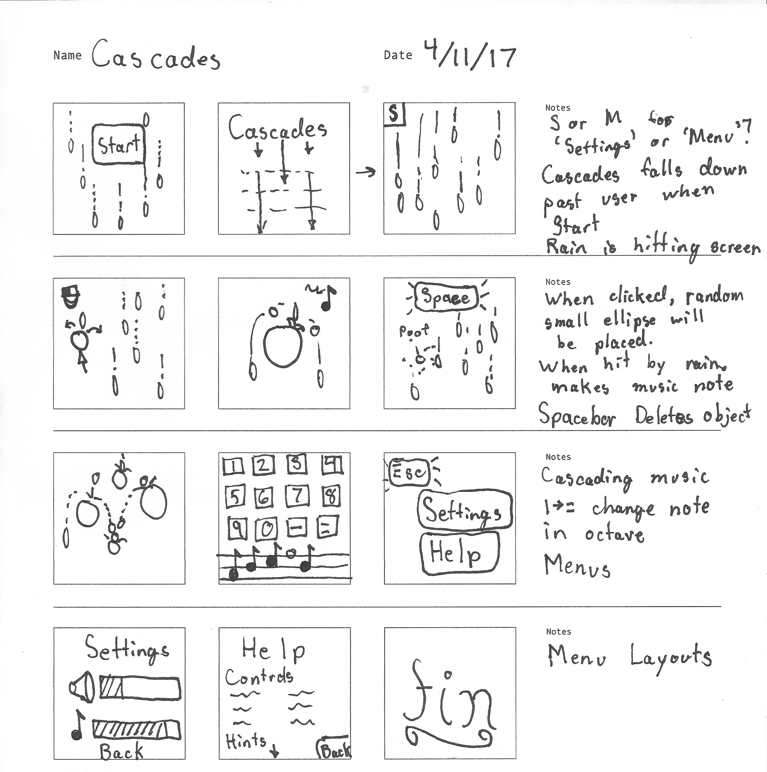
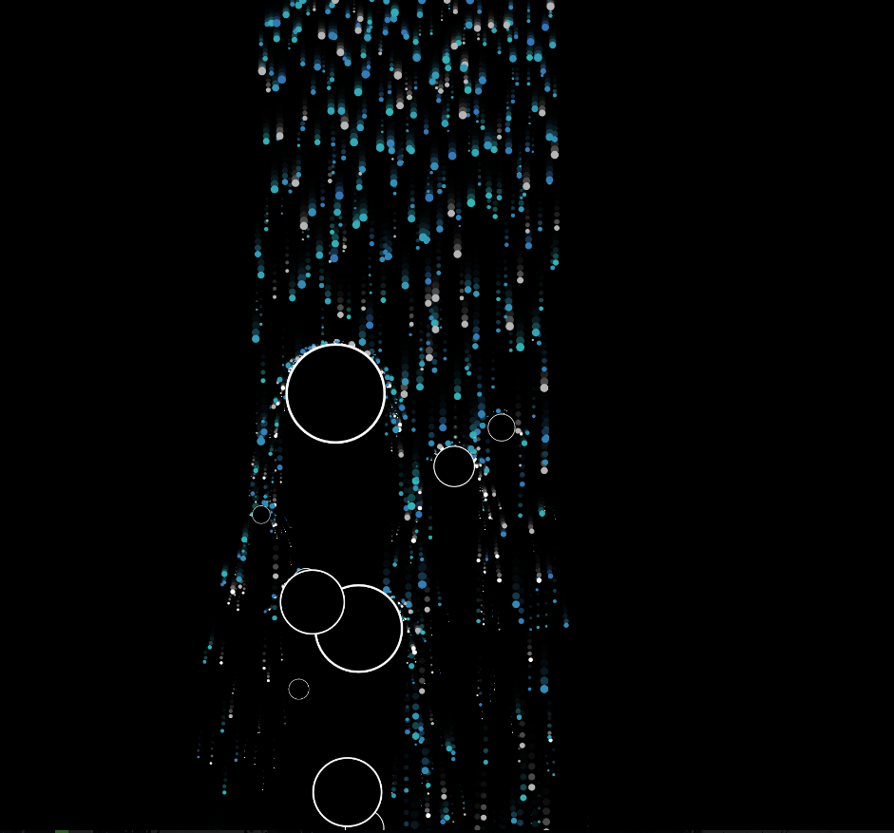
Cascades
Jason Labbe – Open Processing

Slide 4
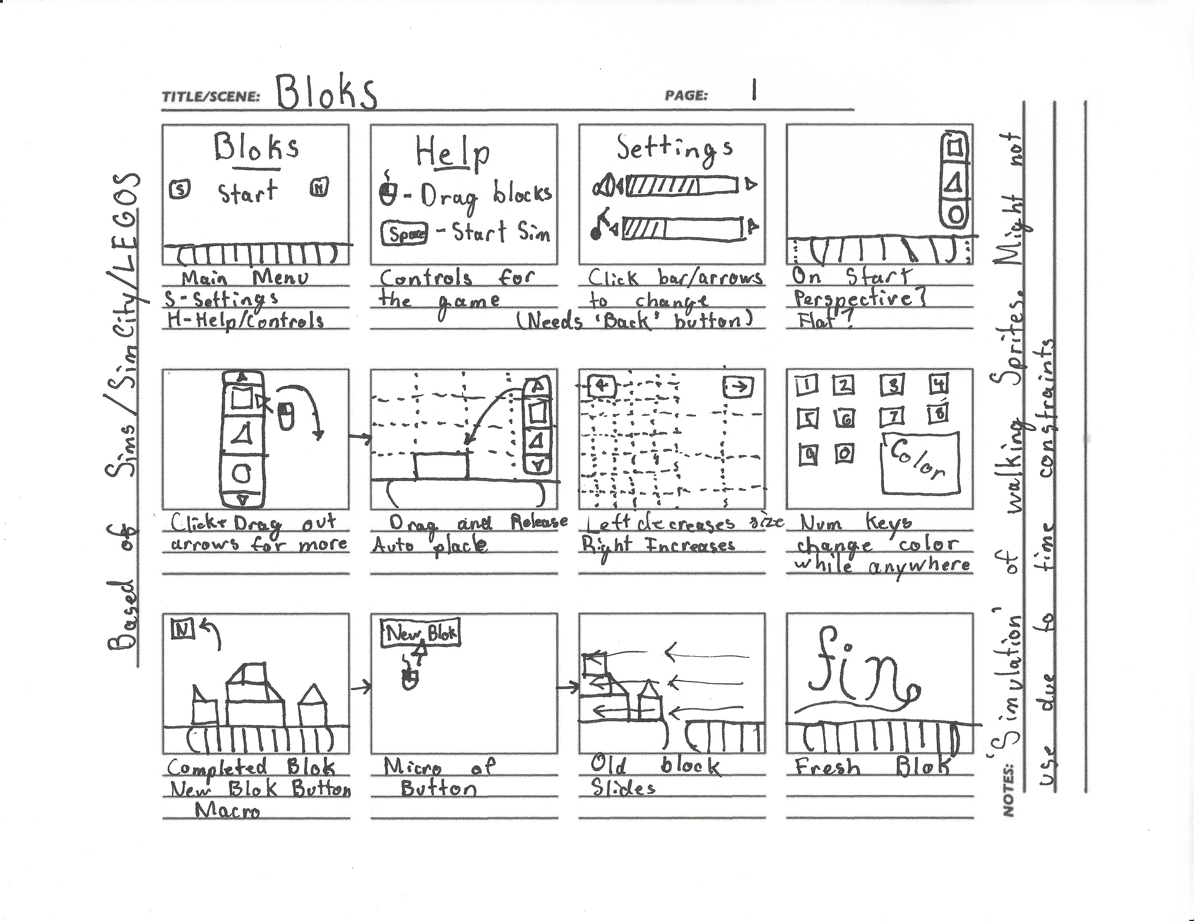
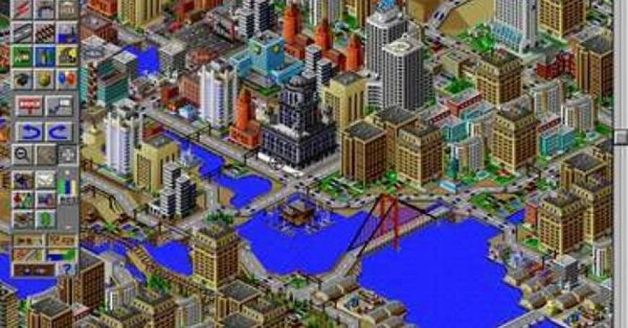
Bloks
Simcity - Game

Slide 5
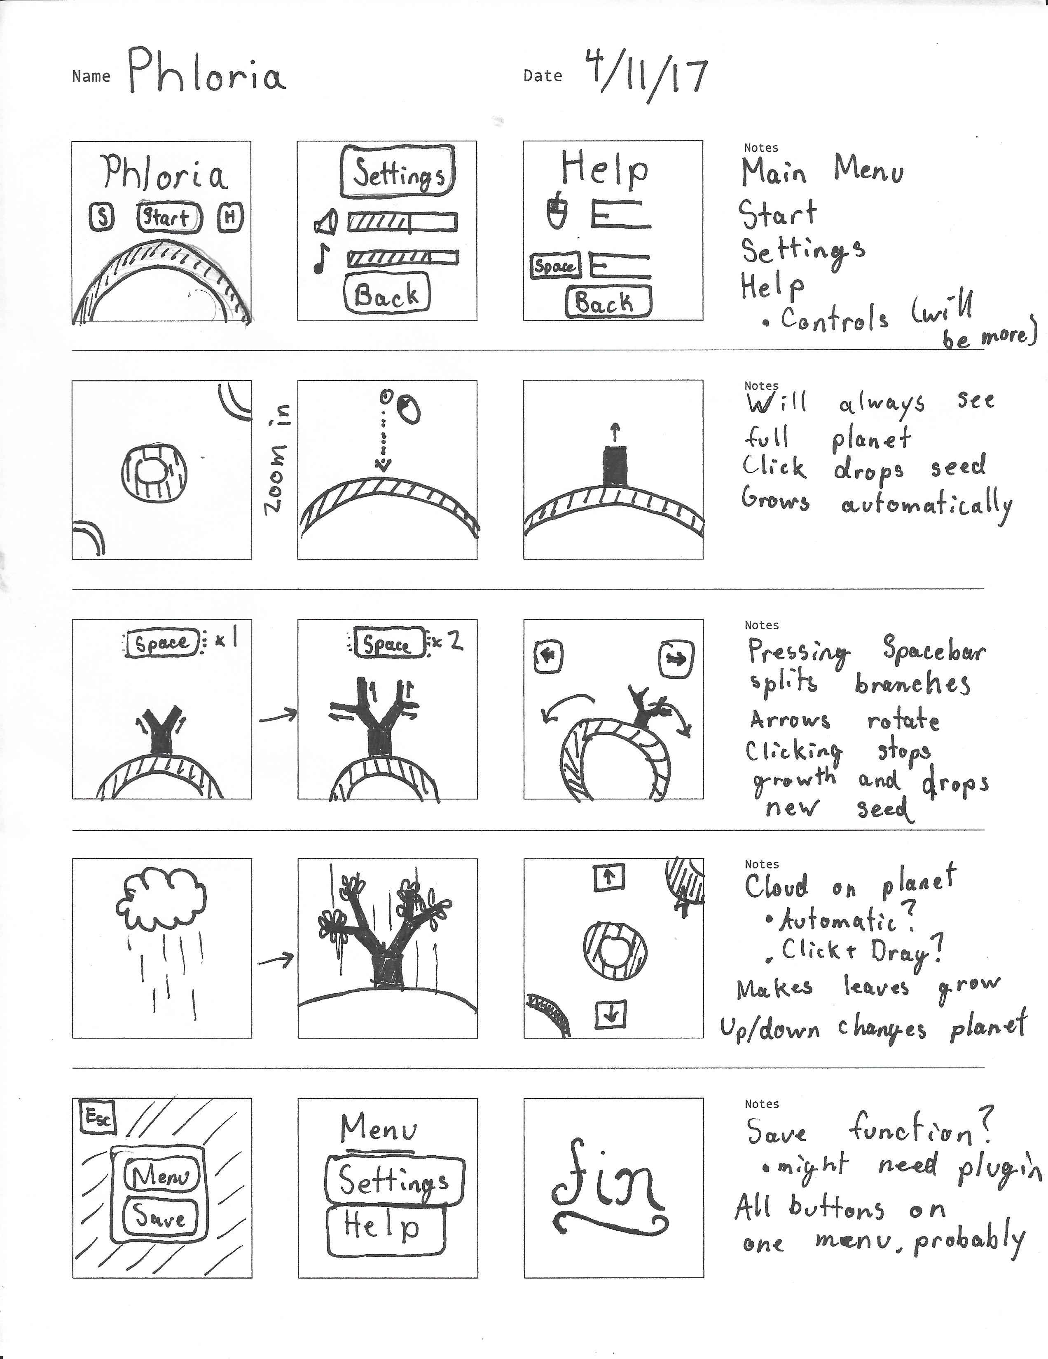

Phloria
Eufloria-game

